Slide 4
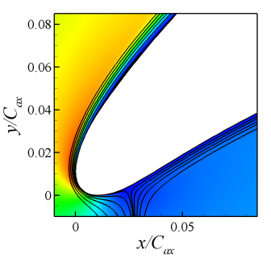
Leading edge separation in clean case

